Slide 1
Joined nanosatellite programs of ISAE-SUPAERO and its partners and regional perspectives
Bénédicte ESCUDIER, ISAE-SUPAERO
Stéphanie LIZY-DESTREZ, ISAE-SUPAERO

Slide 2
Agenda
2
  Introduction: Space activities at ISAE-SUPAERO
  Overview of present and future nano satellites:
    Entrysat
    NIMPH
    SEIS Cube
    JUMPSAT
  CSUT: Student Space Center of Toulouse
  (Centre spatial Universitaire de Toulouse)
  National and international cooperations
  Conclusion

Slide 3

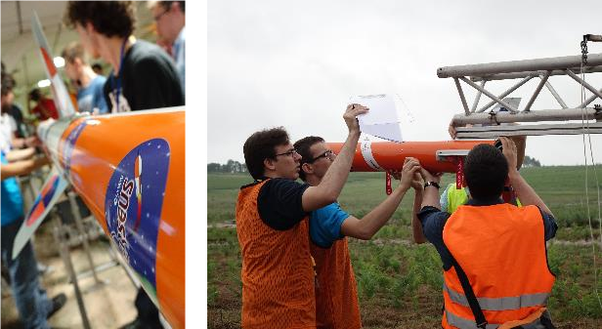
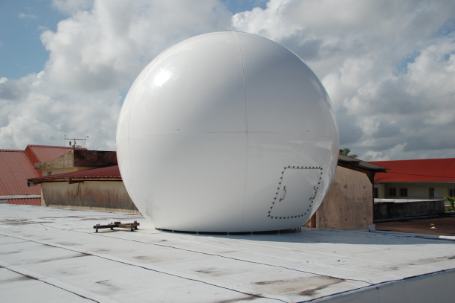
ISAE-SUPAERO Space Activities
3
Education Programmes
Engineering formation (25% of 3rd year students in space domain)
Master’s degrees (e.g. ASEP in collaboration with UPS)
PhDs
Student Projects
Parabolic flights
Cansats
Stratospheric balloons
Micro launcher activities: PERSEUS, Scube
Nano satellites: ENTRYSAT, NIMPH, SEIS Cube, JUMPSAT

Slide 4
4
ISAE-SUPAERO Space Activities
Some Space related research activities
Embedded systems and on-board software, GNC
System engineering, mission analysis, orbital dynamics
Advanced Space Systems design
Active pixel sensors
Tools
Test facilities : TVAC, shaker (vibration testing)
Ground stations (UHF/VHF antenna on Supaéro campus, 2GHz antenna in Cayenne)
Specific software and simulators (flight dynamics calculations, orbital propagations, ADCS)

Slide 5
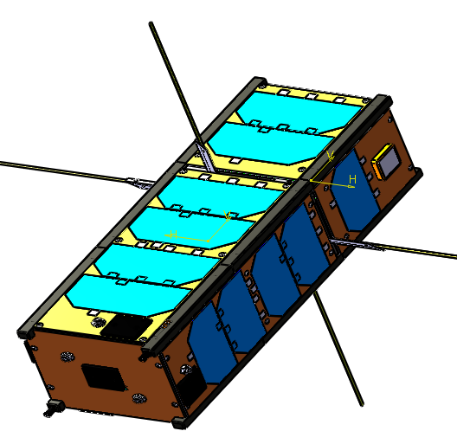




ENTRYSAT
5
3U CubeSat project part of QB 50 VKI Project
Supported by JANUS Programme from CNES

Slide 6

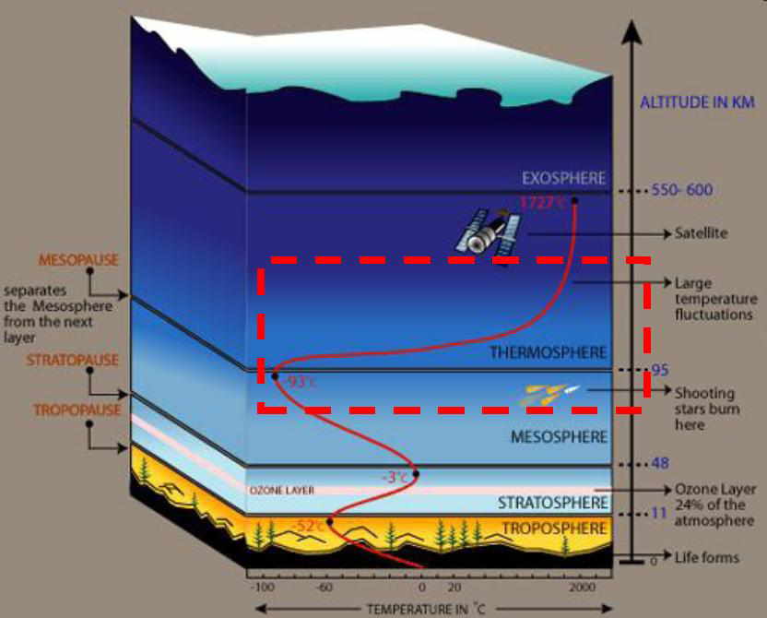
EntrySat : Scientific objectives
6
Dynamics of space debris during re-entry
Aerodynamic pressure variations during re-entry
Satellite integrity during re-entry
Space debris
Thermosphere structure

Slide 7
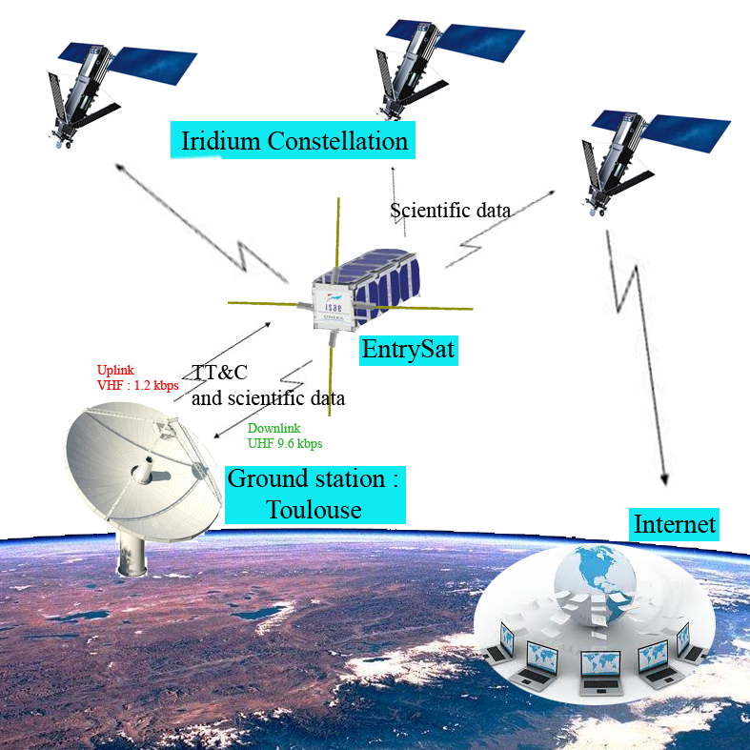
EntrySat : System Architecture
7

Slide 8
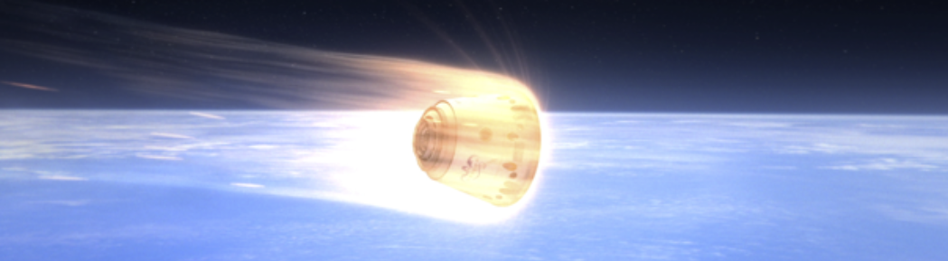
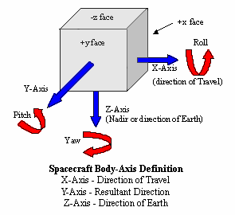
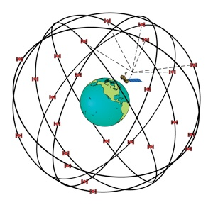
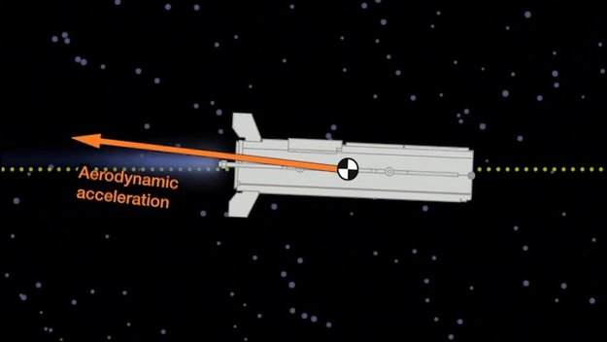
EntrySat : The Payload
8
Heat flux, temperature, pressure on faces + Int. Temp.
Drag and attitude (IMU) Position and orbit (GPS)

Slide 9
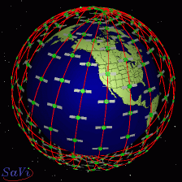
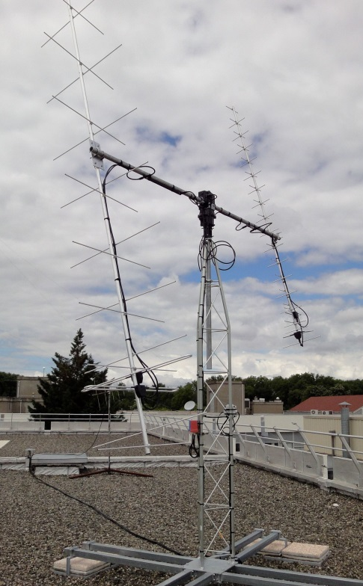

EntrySat : the system elements
9
Iridium
GPS/iridium
Dual band antennas
VHF/UHF
antennas
Ground station
Pressure sensors
Heat flux sensors
Ground segment
(SCS+other tools)

Slide 10

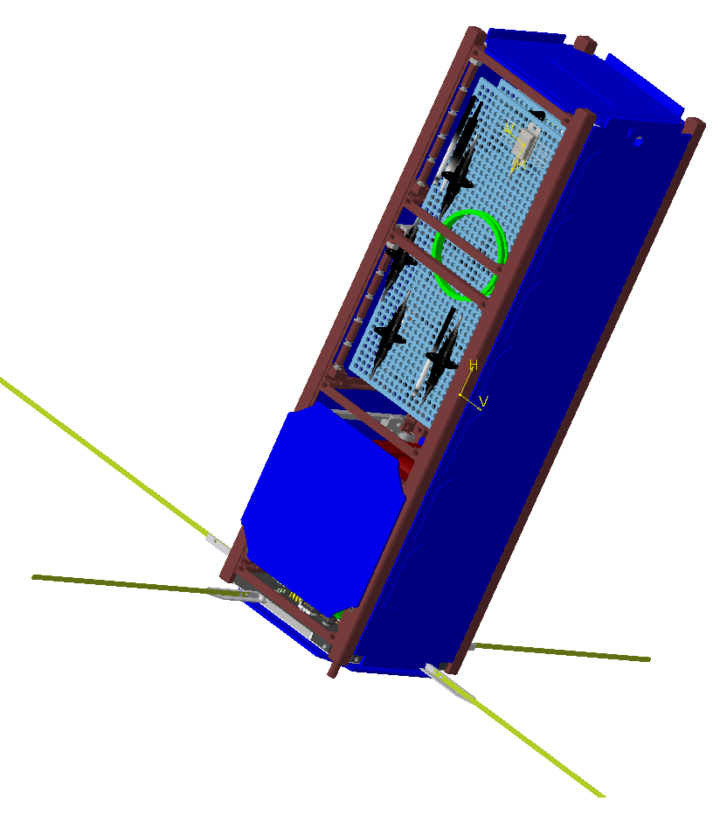




10
NIMPH
NIMPH Project:
Nanosatellite to Investigate Microwave Photonics Hardware

Slide 11
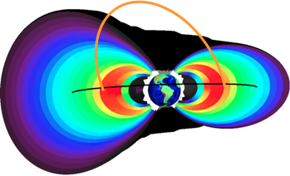
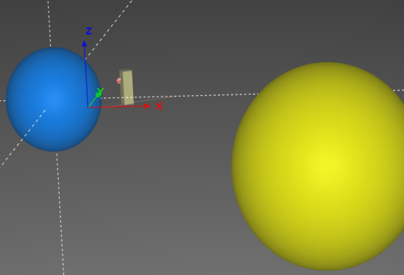
NIMPH : The mission
11
Scientific objectives:
To test optoelectronic components in space environment
To measure the radiation dose received in LEO
Technical objectives:
To test the degradation of the Erbium Dopped Fiber Optics in a radiated environment
To mount a flight meteorology experience of gain and noise of an opto-microwave link

Slide 12
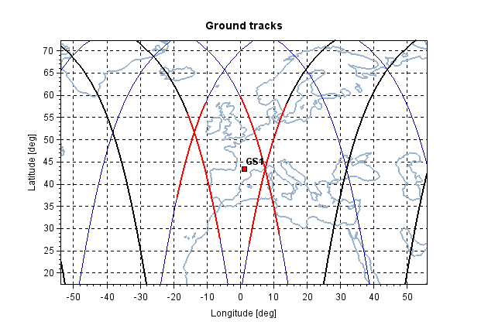
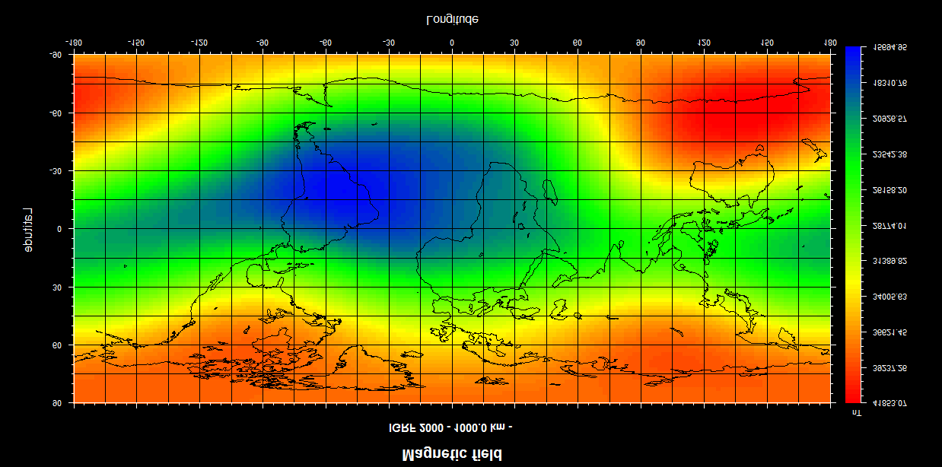
NIMPH : The orbit
12
Requirement : Deposited radiation dose >20 krad on external surface of a panel ➔To maximize radiations dose ➔ Van Allen Belt/ South Atlantic Anomaly
  Mission lifetime : 2 years
  LOS respect
  Expected launch : 2019
Apogee (km) | Perigee (km) | Inclination (°)
650 | 650 | 98

Slide 13
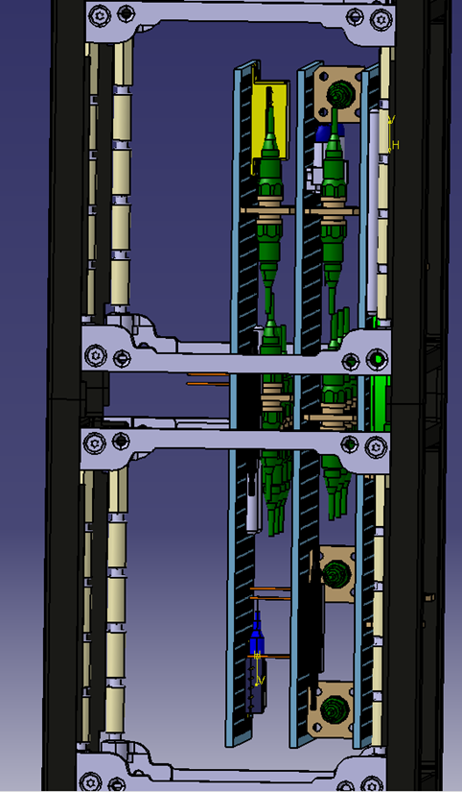
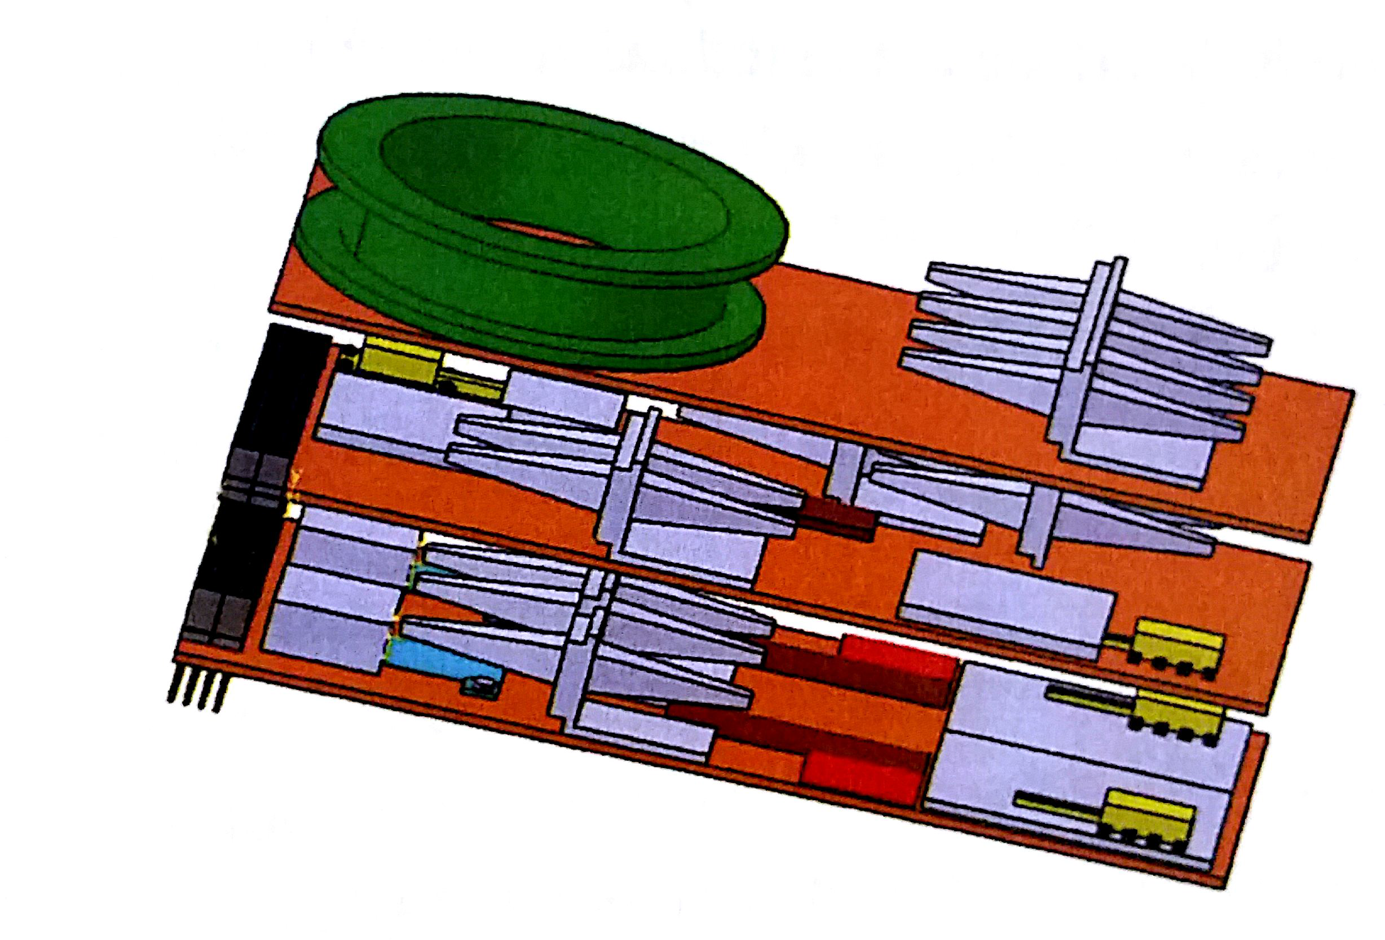
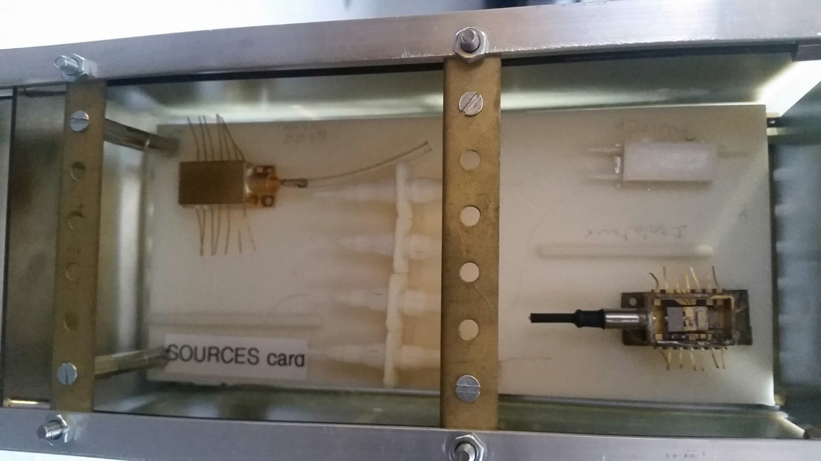
NIMPH : The payload
13
Electronics with compact optical transmission link including :
  Lasers Diodes,
  Electro-Optic Modulator (Mach-Zehnder Modulator),
  Optical Amplifier (EDFA),
  Photodetectors + Electrical Drivers + embedded monitoring
In-flight metrology of the gain and amplitude noise

Slide 14
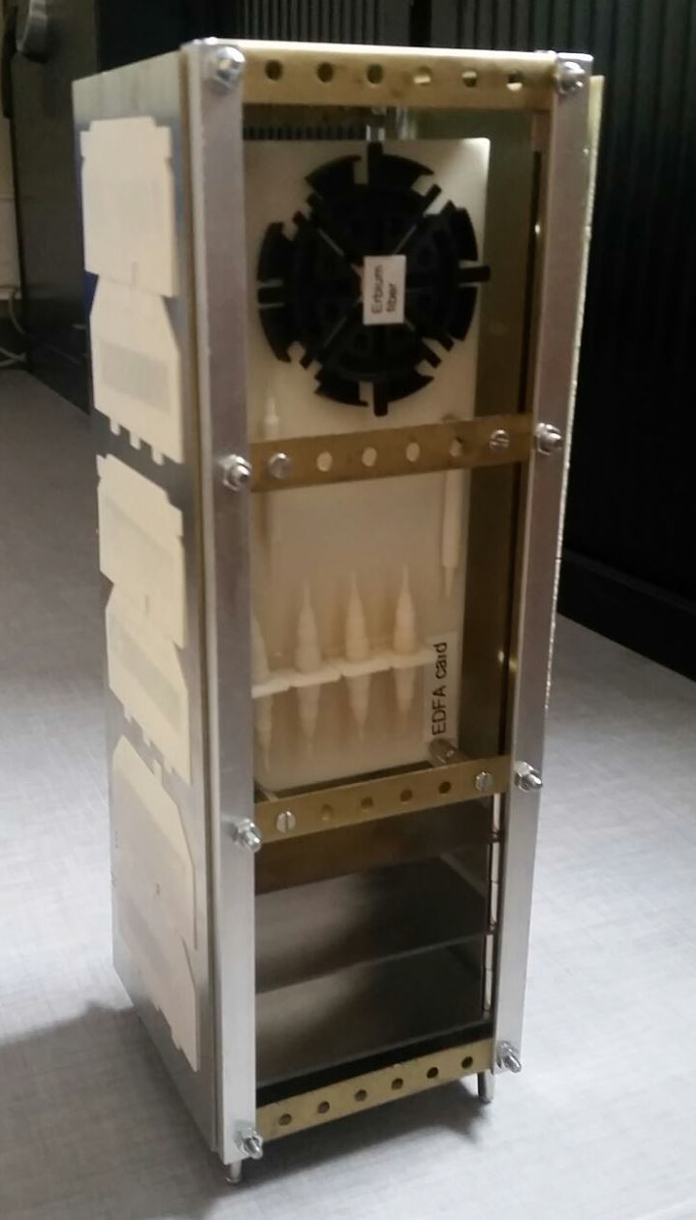

NIMPH : the satellite
14
Ongoing analyses :
- Cmd/Ctrl
- AOCS
Power
Radiations
  Transmission VHF UHF
  Payload Mass 1,9kg
  Cubesat mass 4kg
  Payload electrical Power : 7W
Next analyses :
- Ground segment
- Layout
- Thermal

Slide 15


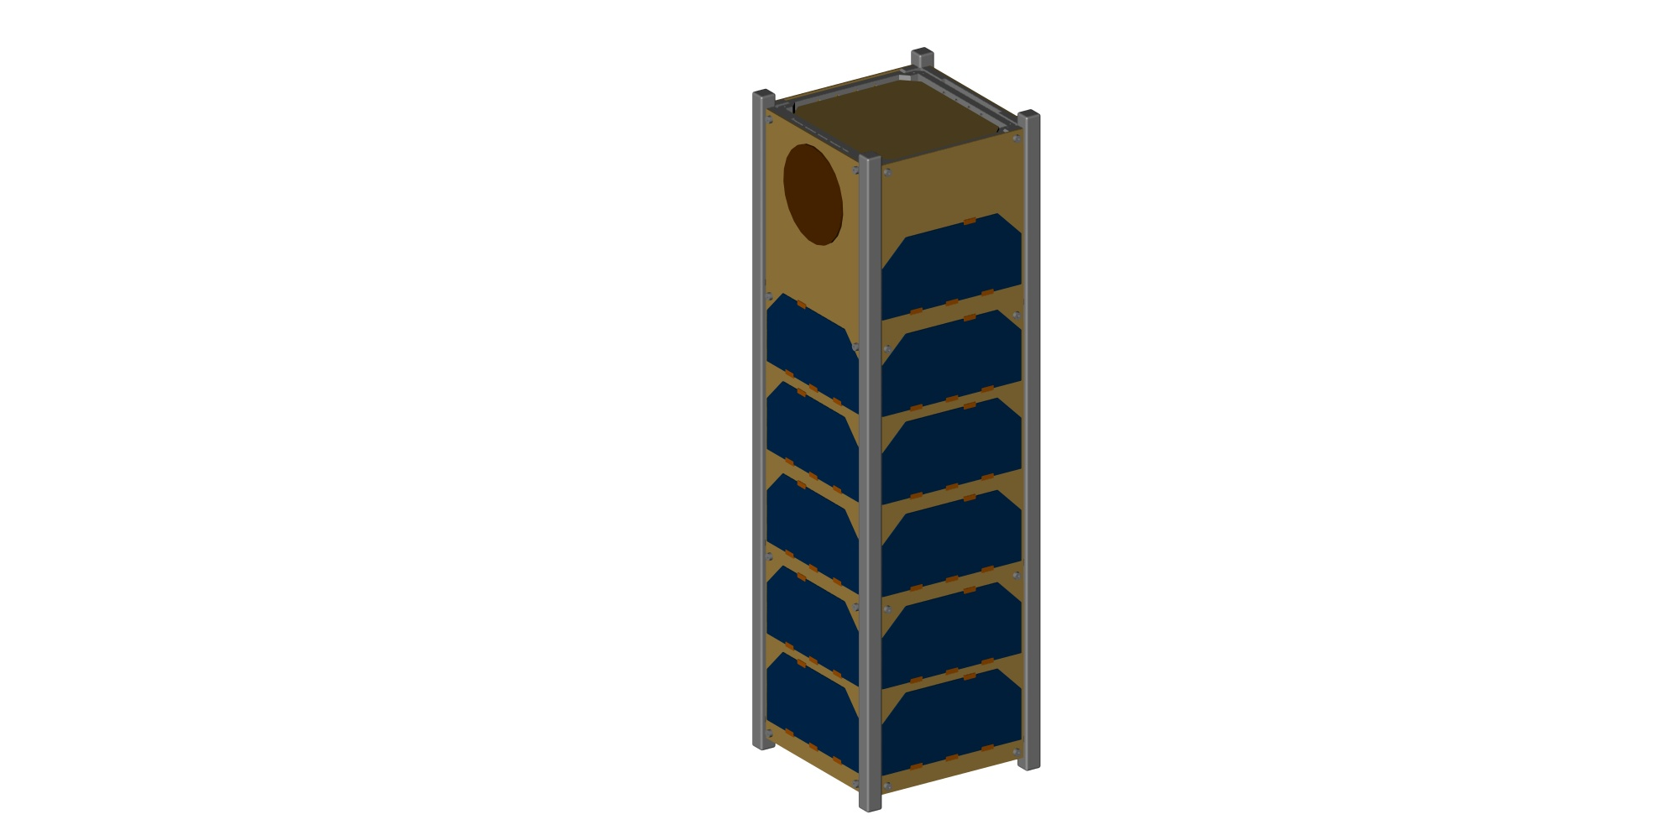
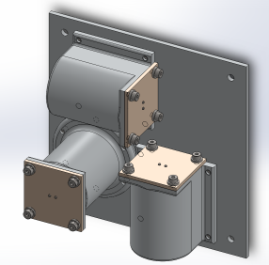
SeisCube
15
The Asteroid Geophysical Explorer (AGEX) is among the proposals selected by ESA in response to a call for ideas for the CubeSat Opportunity Payloads for the AIM mission
SeisCube (one of two 3U CubeSats that together form AGEX) will land a geophysical instrument package on Didymoon, the secondary of the Didymos binary asteroid system
The proposed mission concept combines high science return, a low risk posture and will help secure AIM/AIDA primary mission goals by providing complementary investigations and a deployment strategy assessment
The AGEX team includes the Royal Observatory of Belgium, ISAE-SUPAERO, Antwerp Space, EMXYS and Asteroid Initiatives LLC
The preliminary payload for SeisCube includes:
Geophones
Gravimeter
Accelerometer (MEMS)
Gyroscope (MEMS)
Cameras
Thermal sensors
Radio Link (ISL)

Slide 16
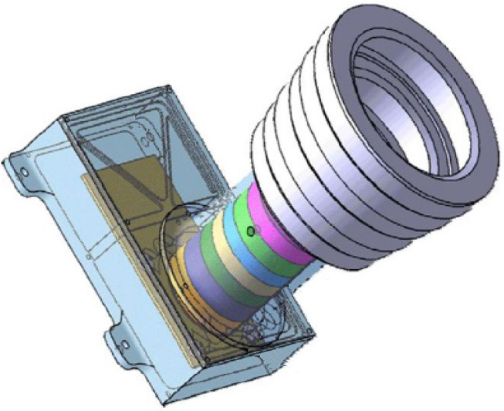
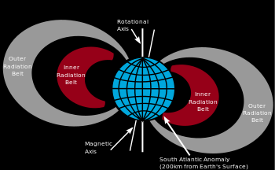



JUMPSAT
16
In-flight qualification of:
  ISAE – SUPAERO Star Tracker
  ONERA - Radiation Sensor : Dynagrad
  ISAE- SUPAERO - 3-axes Attitude and Orbit Control System (AOCS)

Slide 17
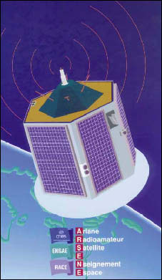
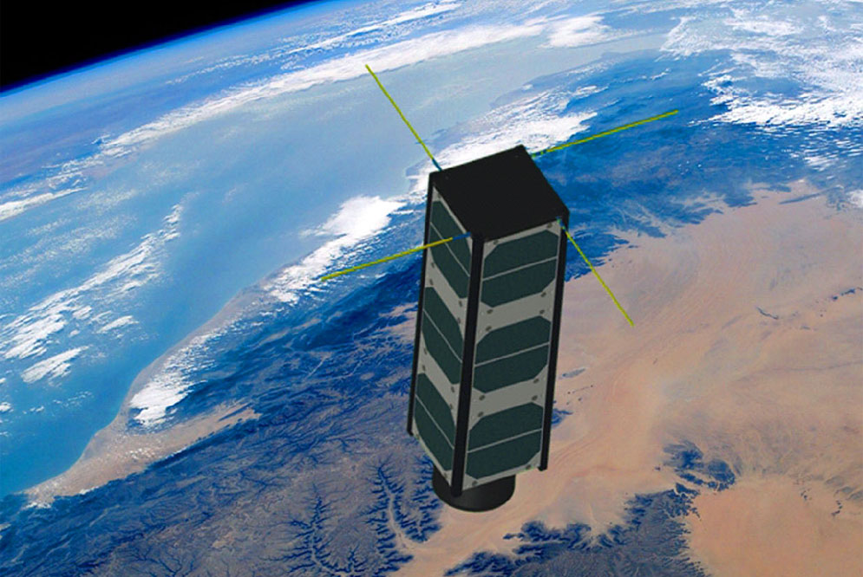
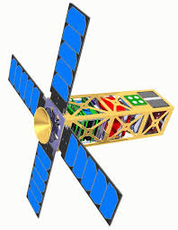
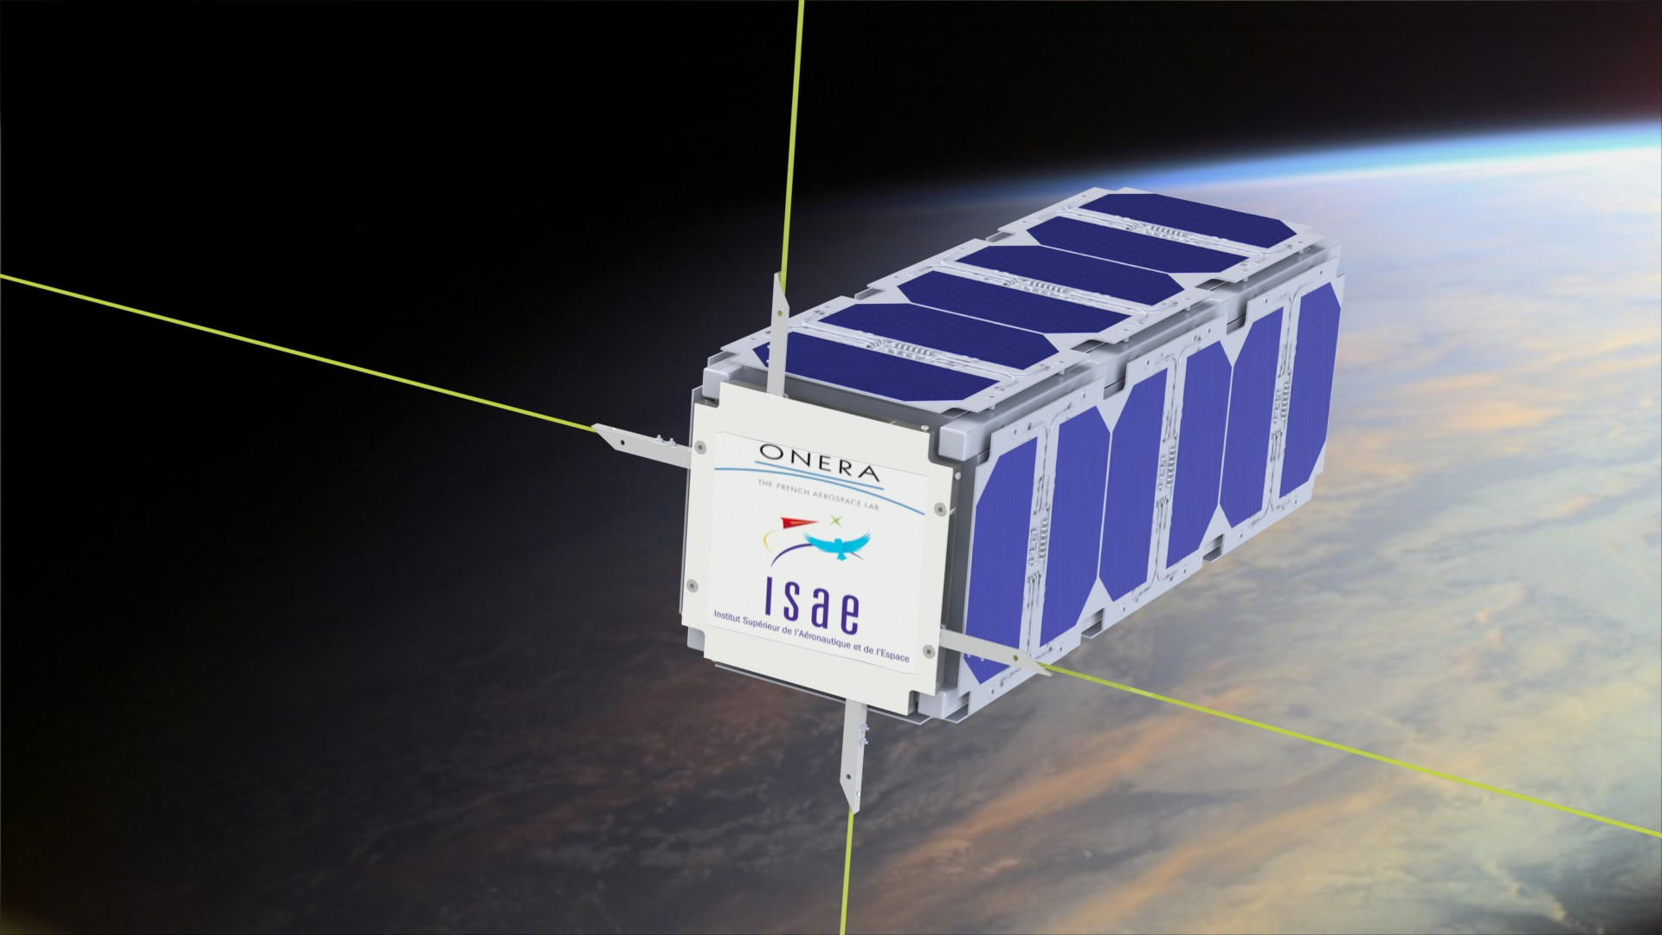
Nanosatellite roadmap
17
2019
Arsene
Jumpsat
2016
Nimph
Ground segment
Eyesat
SeIScube
Entrysat

Slide 18

Student Space Center in Toulouse
Centre Spatial Universitaire de Toulouse (CSUT)
« From hands-on training
towards national and international cooperation »

Slide 19

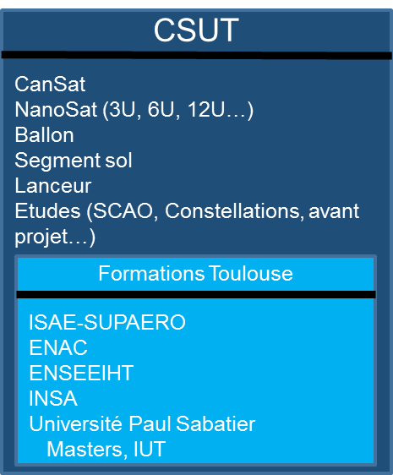
CSU in Toulouse
Excellence of Toulouse Space Education Programmes
Development of cooperations between members and
partners of CSUT
Development of graduates professional insertion
Education
Visibility of Space research and training programmes in Toulouse via national and international cooperation
Bring closer
Education and industry
Bring closer
Education and laboratories
Reinforce the links between research activities and training activities
Develop relationship between science projects and technological /engineering innovations
Reinforce links between universities and industry
Develop innovative technologies and applications
Help to the development of start-ups
Laboratories
Industry

Slide 20
CSUT: partnership & organization
Members of CSUT in 2016 for the GIS consortium agreement:
Academic members
  ISAE-SUPAERO, UT3 Paul Sabatier, ENAC (Ecole Nationale de l’Aviation Civile), INPT (Institut national Polytechnique de Toulouse/ENSEEIHT),
  INSA (Institut National des Sciences Appliquées de Toulouse)
Research members
  Laboratories CNRS/UPS: LAAS (Laboratoire d’Analyse et d’Architecture des Systèmes), IRAP (Institut de Recherche en Astrophysique et Planétologie)
  ONERA (French Aerospace Laboratory – Toulouse Center)
  First Associate Partner : CNES
Other and future partners
Aerospace Valley
Industrial partners: Airbus DS, TAS, SMEs ( EREMS, MecanoID,..), Telespazio, CLS..
IRT
RTRA
Other laboratories (IRIT, ICA, CESBIO, LEGOS, CNRM,…)

Slide 21
CSUT: National cooperation
Network of existing and planned Student Space Centers and joint projects
University of Montpellier: CSUM/ Van Allen Foundation; First nano satellite from a French University. Cooperation on existing and future projects.
Paris
  Saclay, Ecole Polytechnique Student Space Center: Xcubesat
  University of Paris Diderot: IGOSAT project
Grenoble: CSUG
Cooperation in the frame of PERSEUS Programme

Slide 22
CSUT: International cooperation
European cooperation
  Opportunity of partners from European Space Master, ECATA and PEGASUS Network, other German, Italian partners
  Switzerland: EPFL, ETHZ
Examples of existing international cooperation
  Japan: Kyushu for micro « space shuttles » demonstrators
  Russia: Samara, Moscou (Bauman)
  USA
    MIT: existing cooperation on GNC and use of Cayenne ground station
    NASA/JPL/Caltech

Slide 23
Conclusion
CSUT: better coordination of universities and laboratories « nano space systems » research activities and projects in Toulouse area
Better efficiency for collaborative projects of nano space systems
Optimization of integration and test facilities and system engineering and design methods
Need for national and international cooperation and development of « Space » networks
Opportunities for innovation and joint developments for science and technology
Support to development of start-ups in the field of space systems and applications
Next step: end of June 2016 !
First event: end of 2016

