Slide 1
Eye-Sat : a student triple CubeSat for astronomy
Antoine Ressouche – aressouche@irap.omp.eu
1er workshop CubeSat étudiant, le 10/06/2016

Slide 2


Introduction
Eye-Sat, a driving student project for a performant nanosatellite
  Understand the student CubeSat development process
  Make a very efficient 3U CubeSat
Objectives :
  Educational : build a triple CubeSat with students in less than 5 years in order to promote space engineering
  Scientific : measurement of intensity and polarization of the zodiacal light in 4 spectral bands
  Outreach : 360° colored picture of the Milky Way
  Technological demonstration
Context
  About 2,5 people/year for coordination
  6-months interns at CNES throughout the entire project
  IUT interns (2-3 months)

Slide 3
Organization

Slide 4
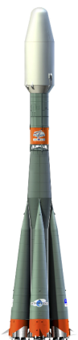
Planning
C. CHOMEL
N. BOUCHER
M. NUNEZ MUGUERZA
M. RUIZ RIVILLA
C. LUBEIGT
O. LAGRANGE
E. COUTURIER
A. MZABI
C. SOMMER
VHDL
L. ORTEGA ESPLUGA
C. GASNIER
A. NOLLE
N. FIFIS
F. CHAUBEYRE
C. MASSON
A. DESLANDES
G. CANARD LUQUE
A. GENIS
C. DE RESSEGUIER
M. ROULANCE
A. BOUNOUARA
E. CARRIE
T. DE SAINTIGNON
F. NUSBAUM
E. MEURGUES
C. HEBRARD
F. DAUVERGNE
C. FANCELLI
V. WATRELOT
N. HUMEAU
M. ROULANCE
M. CARL
M. HAUTEM
A. BOUNOUARA
C. DEMASSON
Q-V. NGUYEN
C. LABIT-BONIS
Y. TRAORE
Z. BOKAL
S. DE GAETANO
Etudiants ENAC (projet JAVA)
O. LEZAUD
Ready for launch : June 2017
F. APPER
J-L. DEMONTFORT
E. CARRIE
F. NUSBAUM
Masters SME (UPS)
A. BOUNOUARA
C. DEMASSON
Q-V. NGUYEN
A. PACAUD
J. GALINELLI
N. TOUNSI
G. DRISS
J. SKODA
M.PECH
C. CHALUMEAU
C. CHOMEL
N. BOUCHER
J-P. AUGE
W. FAYSSE
Q. ROHAN
M. AVERSENG
B. LAUNET
A.LEBOUCHER
M. ROULANCE
A. BOUNOUARA
V. NGUYEN
F. APPER
M. ELMALEH
M. HAUTEM
A. BOUNOUARA
C. HOLLARD
R. HABAZ
T. CABOURDIN
F. VIAUD
M. AVIGNON
K. NOCENTINI
A. RESSOUCHE
F. APPER
M. ELMALEH
M. HAUTEM
A. BOUNOUARA
R. HABAZ
T. CABOURDIN
T. CAPOCCI
A. PALUN
A. RESSOUCHE
M. MONTORO
Phase D
Phase C
Sept
2016
Mar
2017
Phase B
Phases 0/A
Mar
2016
Sept
2014
Mar
2015
Sept
2015
Sept
2013
Mar
2014
Sept
2012

Slide 5
Internal view
Stellar sensor
Cap
Interface board
X-band transmitter
Payload
S-band antenna
X-band antenna
Reaction wheels
OBC
S-band transceiver
Magnetotorquers board
Power board

Slide 6
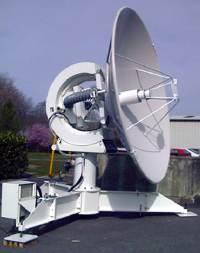
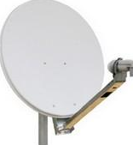
Ground segment
Bande X
PLTM : 15 Mbps
Bande S
TC : 8 Kbps
HKTM : 85 Kbps
PLTM
TC
HKTM
TETX
STC
Réseau multi-mission du CNES
Désignations
Logbook
PLTM
Prévision/restitution d’attitude et d’orbite
Données auxiliaires
HKTM
Plan TC
Ephémérides
Disponibilités
Centre de mission (CM)
Centre de commande-contrôle (CCC)
Plan de travail (IRIS, guidage, vidage PLTM)

Slide 7
Theory
Faisabilty studies
Preliminary definition
Precise conception
AIT
Qualification
Exploitation
Phases 0/A
Phase B
Phase C
Phase D

Slide 8
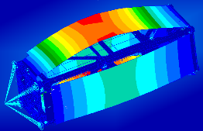
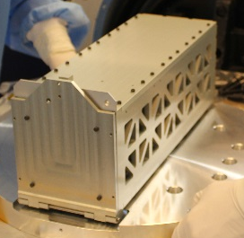
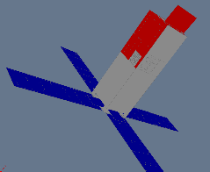
Structure and thermal control
Computer Assisted Design
Simulations on Finite Element Model
Tests on STM
Qualification on QM
Thermal Analysis
Simulations on thermical numerical model
Thermal architecture definition
Software development
Qualification on QM
Phases 0/A
Phase B
Phase C
Phase D

Slide 9
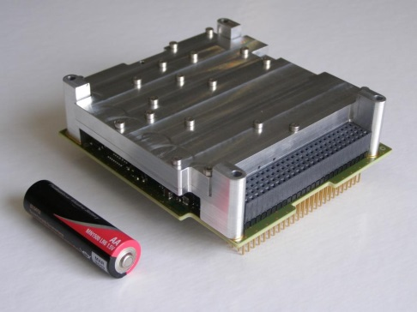
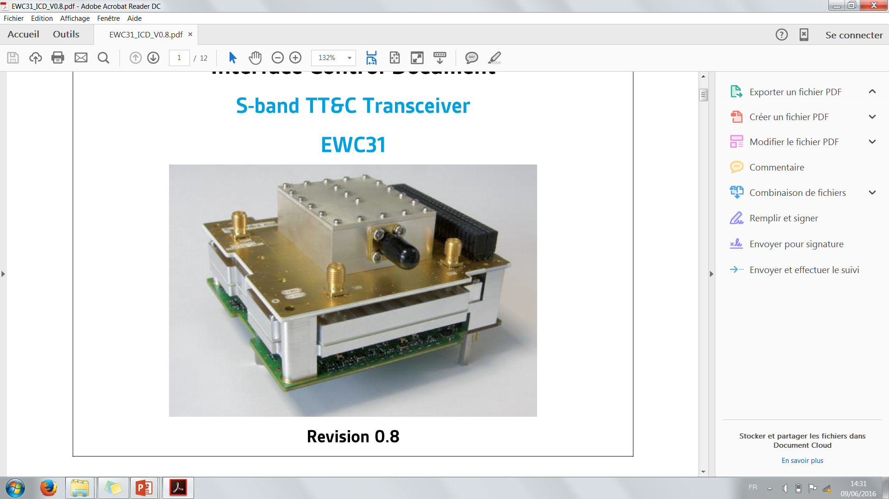
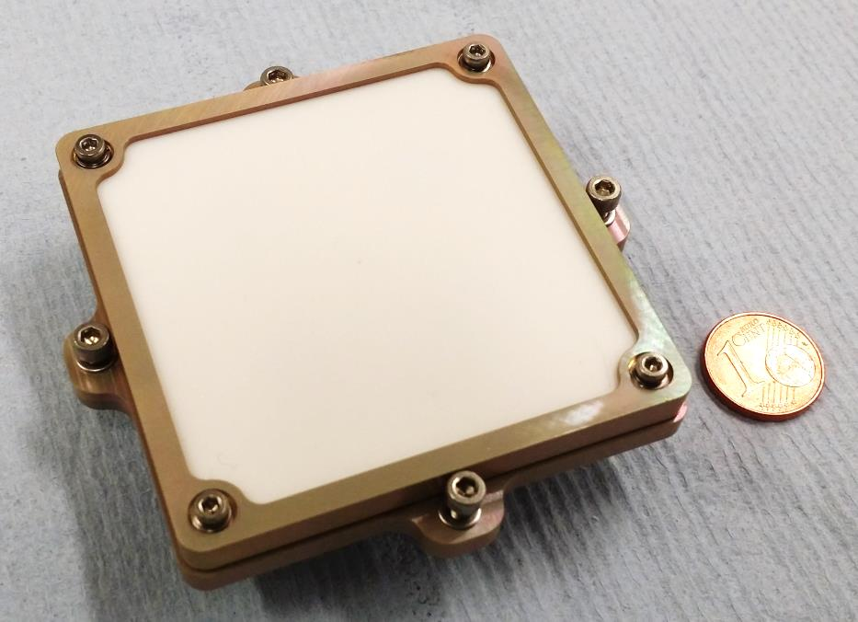
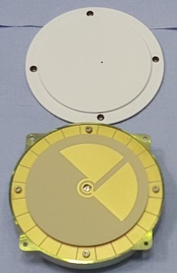
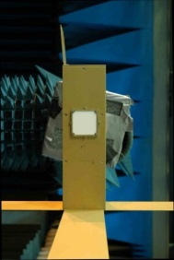
Telecommunications
CNES R&D
Functional tests
Ground to space tests
Qualification on QM
Conception EM
Functional tests (BCMA)
Thermal vacuum
Conception EM
Qualification on QM
Functional tests (BCMA)
Thermal vacuum
Qualification on QM
Phases 0/A
Phase B
Phase C
Phase D

Slide 10
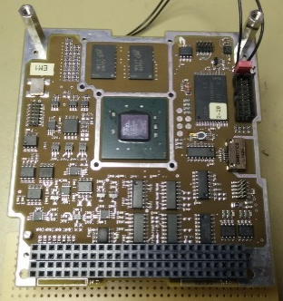
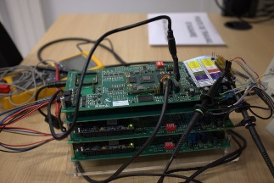

Onboard Computer
CNES R&D
Radiation tests
Qualification on QM
I/Os (FPGA) development
I/Os (FPGA) validation
Drivers software development
Drivers software validation
Phases 0/A
Phase B
Phase C
Phase D

Slide 11
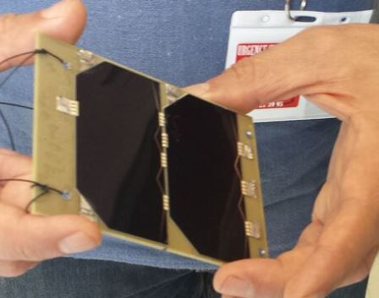
Electrical Power System
Power Analysis
Electrical Power System Architecture
Power board EQM
Interface board EQM
Solar panels manufacturing and testing
Qualification on QM
Phases 0/A
Phase B
Phase C
Phase D

Slide 12
GNC
GNC requirements
Architecture definition
Equipments choice
Software development (Matlab/Simulink)
Software validation on ADCS simulator
C Autocoding
Software validation on system bench
Phases 0/A
Phase B
Phase C
Phase D

Slide 13
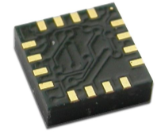
Magnetometer
ADCS requirements
Architecture definition
Equipments choice
Functional tests
Functional tests
Qualification on QM
Phases 0/A
Phase B
Phase C
Phase D

Slide 14
Magnetotorquers
ADCS requirements
Architecture definition
Equipments choice
Prototype development
Functional tests
QM manufacturing
Qualification on QM
Phases 0/A
Phase B
Phase C
Phase D

Slide 15
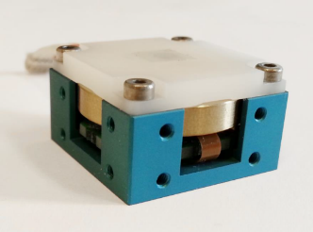
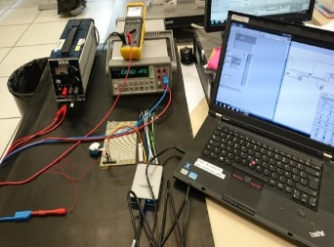
Reaction wheel
ADCS requirements
Architecture definition
Equipments choice
Delivery
Functional tests
Delivery
Functional tests
Phases 0/A
Phase B
Phase C
Phase D

Slide 16
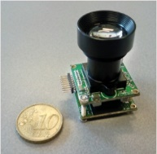
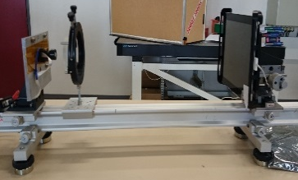
Startracker
ADCS requirements
Architecture definition
Equipments choice
Delivery
Functional tests
Delivery
Functional tests
Phases 0/A
Phase B
Phase C
Phase D

Slide 17
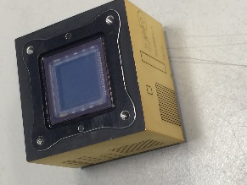
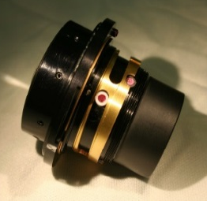
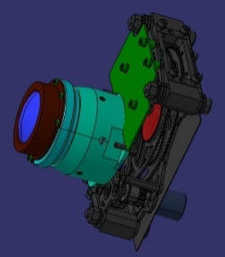
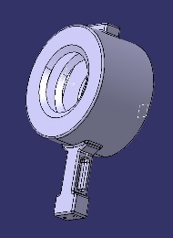
Payload
Preliminary design
Microcaméra R&D
Optics choice
Thermal & vibrations tests
Filter wheels design
Functional tests
Filter wheels design
Baffle design
AIT
Qualification on QM
Phases 0/A
Phase B
Phase C
Phase D

Slide 18
Command/control
Command/Control definition
FDIR definition
BDS conception
TM/TC onboard software development
TM/TC ground software development
Preliminary operation concept
OPS definition
Phases 0/A
Phase B
Phase C
Phase D

Slide 19
Conclusion
Definition is time consuming !!!
Test every equipment you buy
We will learn a lot on the qualification model

Slide 20
Questions ?

